Slide 1
Module 2 – Leadership
Chapter 2 – Qualities of a Leader
Section 2 – Conduct in Uniform

Slide 2
Demonstrate knowledge of the challenge of leadership, the qualities of an effective leader, how to evaluate the performance of subordinates and how to give instruction

Slide 3
Describe the value of initiative and ingenuity in the military service
Compare courage to moral courage
Explain the importance of a leader’s ability to organize and to make decisions
Describe the importance of leading by personal example
Explain why mutual trust and confidence are important aspects of effective leadership

Slide 4
Key Term Questions Slide Index
Click any link below to go directly to polling that question.
Becoming overly familiar with personnel of lower rank
Unsolicited advances of one service member toward another based on sexual attraction
Penalizes good people while favoring bad ones
Violation of law, agreement, or rules
Becoming too familiar with subordinates
Click here to return to this index.

Slide 5
Team Assignment
Alpha
Bravo
Charlie
Delta

Slide 6
Becoming overly familiar or developing close personal relationships with personnel of lower rank, especially those in their immediate chain of command
Ignorance
Fraternization
Association
Antagonism
1
1
1
1
(NS3-M2U1C2S2:KT1)

Slide 7
Unsolicited or otherwise undesirable or inappropriate advances of one service member toward another based on sexual attraction, especially involving promises, rewards, or threats of punishment or other forms of intimidation
Fraternization
Bribery
Infraction
Sexual Harassment
1
1
1
1
(NS3-M2U1C2S2:KT2)

Slide 8
When related to disciplinary action, it penalizes good people while favoring bad ones
Intolerance
Compassion
Leniency
Benevolence
1
1
1
1
(NS3-M2U1C2S2:KT3)

Slide 9
A violation or infringement of a law, agreement, or set of rules
Infraction
Breach
Transgression
Compliance
1
1
1
1
(NS3-M2U1C2S2:KT4)

Slide 10
Becoming too familiar with subordinates; often results in difficulty leading them
Fraternizing
Knowledgeable
Familiarity
Experienced
1
1
1
1
(NS3-M2U1C2S2:KT5)

Slide 11
Fraternization -
Becoming overly familiar or developing close personal relationships with personnel of lower rant, especially those in their immediate chain of command

Slide 12
Sexual Harassment -
Unsolicited or otherwise undesirable or inappropriate advances of one service member toward another based on sexual attraction, especially involving promises, rewards, or threats of punishment or other forms of intimidation

Slide 13
Leniency -
Leniency related to disciplinary action penalizes good people while favoring bad ones
Infraction -
A violation or infringement of a law, agreement, or set of rules
Familiarity -
Becoming too familiar with subordinates will often have difficulty leading them

Slide 14
Explain what discipline is and the benefits to a military unit.
1.
2.
3.
Note to Instructors:
Click the Show/Hide Response Display Button

Slide 15
How ready are you to learn today?
Distracted - I’ll admit, my mind is elsewhere.
Tired - I feel a bit worn down.
Focused - I’m on it.
Energized - I am a superhero!!
1
1
1
1
(NS3-M2U1C2S2:LQ1)

Slide 16
Both fraternization and sexual harassment are subject to separation from the service.
True
False
(NS3-M2U1C2S2:LQ2)

Slide 17
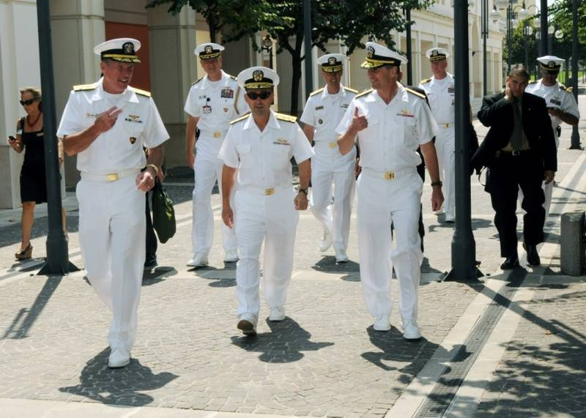
Conduct in Uniform
Causes of Poor Conduct
Some common causes of poor conduct are:
Dissatisfaction with unit, ship, or station conditions
Dislike of work assignment or living conditions
Feeling of unfairness regarding policies
Troubles at home

Slide 18
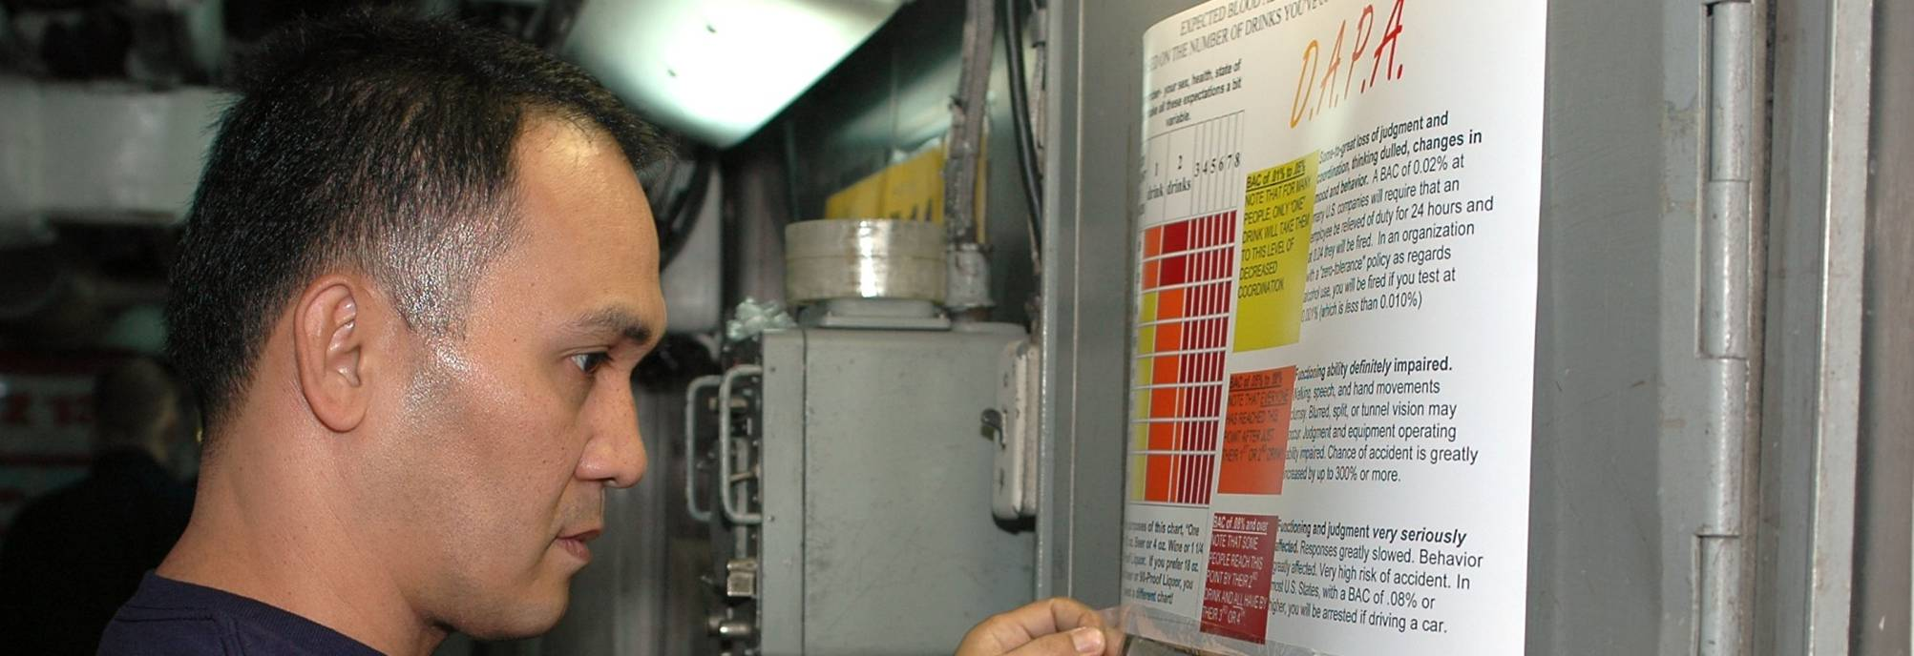
Conduct in Uniform
Poor Conduct of Subordinates
Weaker subordinates may resort to:
Unauthorized absence
Alcohol or substance abuse
Other forms of escape

Slide 19
Conduct in Uniform
Prevent, Remind, Prepare
As a leader, do all you can to prevent improper actions by naval personnel.
Remind subordinates of their responsibility to conduct themselves properly at all times.
Be prepared to perform the duties of subordinates whenever required to do so.

Slide 20
Conduct in Uniform
Corrective Actions of Leaders
By regulation and for practical reasons, leaders accept responsibility for corrective action.
Before leaders take corrective action they must:
Know their personnel
Take care of their needs
Insist on acceptance and exercise of moral responsibility

Slide 21
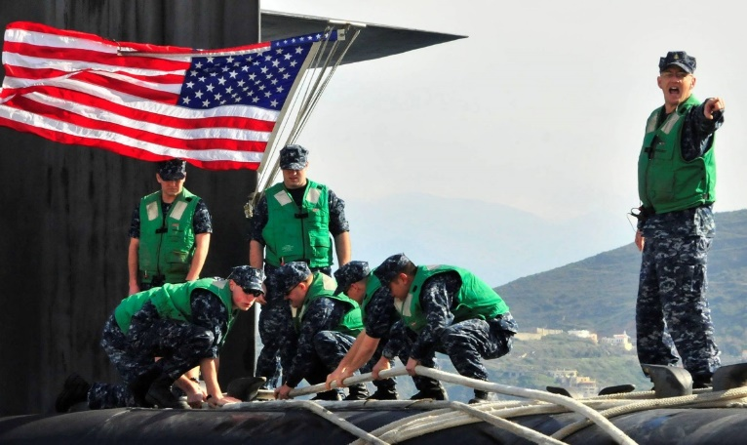
Discipline
Discipline:
Is the basis of true democracy
Requires rules of conduct that are desirable in civilized society
Does not deprive individuals of fundamental rights
Protects everyone’s equal rights

Slide 22
Discipline
Laws and Conventions
Laws are formal rules that are put into effect by duly constituted authority, such as a city council or state legislature.
Conventions are informal rules that have become a part of our culture by custom and usage.

Slide 23
Discipline
What is Discipline?
Discipline is:
Training that develops self-control, character, or efficiency
Control of conduct so there can be coordination of effort for the good of all

Slide 24
Discipline
Definitions of Discipline
Some definitions of discipline are:
Control gained by enforcing obedience.
That state of orderliness gained through self-control and orderly conduct.
That degree of control which moves an organized group to appropriate action upon receipt of an order, or in anticipation of that order when circumstances prevent its being given.

Slide 25
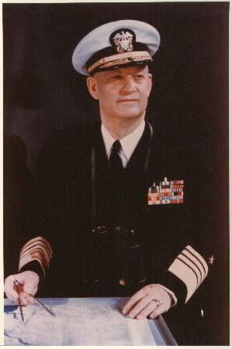
Discipline
Admiral Burkes’ Definition of a Well-Disciplined Organization
“A well-disciplined organization is one whose members work with enthusiasm, willingness, and zest, as individuals and as a group, to fulfill the mission of the organization with expectation of success.”

Slide 26
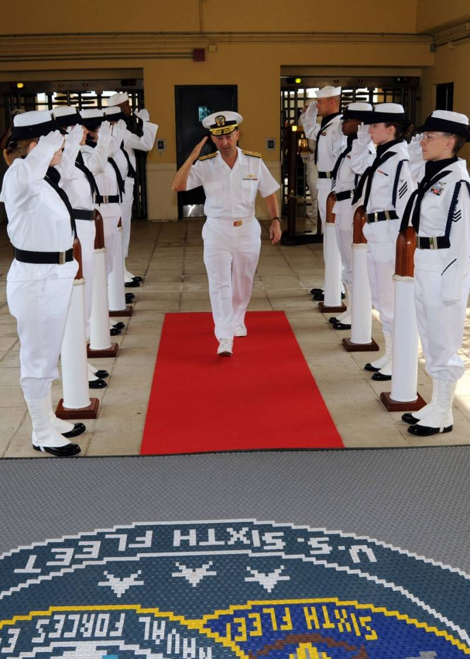
Discipline
Signs of Discipline
Here are some indications of well-disciplined Sailors:
Smart salutes
Proper uniform wearing
Correct emergency action

Slide 27
______ are formal rules that are put into effect by duly constituted authority.
Disciplines
Conventions
Regulations
Laws
1
1
1
1
(NS3-M2U1C2S2:LQ3)

Slide 28
Which of the following are true about discipline? (Input all that apply, then push the ENTER button.)
Discipline is the basis of democracy.
Discipline requires rules of conduct that are not desired in civilized society.
Discipline deprives individuals of fundamental rights.
Discipline protects everyone’s equal rights.
1
1
1
1
(NS3-M2U1C2S2:LQ4)

Slide 29
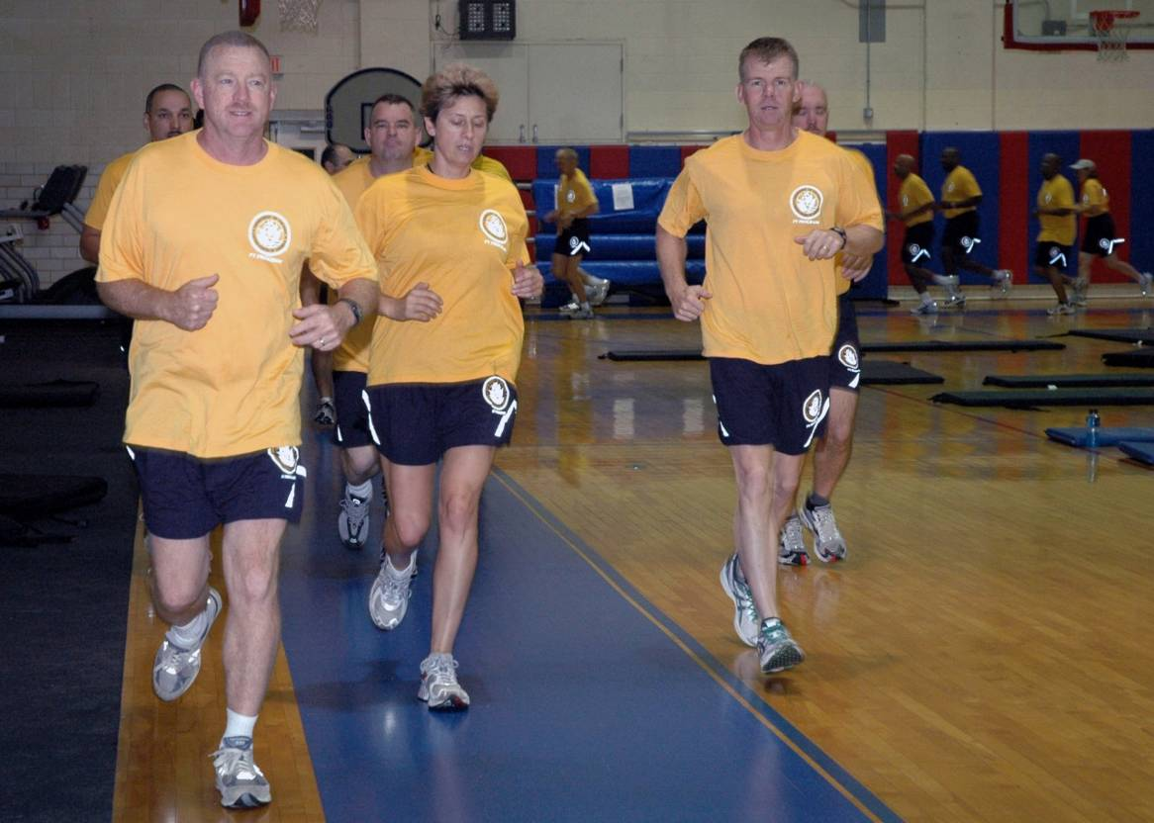
Discipline
Purpose of Discipline
The purpose of discipline is to develop an efficient organization of personnel who are trained to achieve a common goal.

Slide 30
Discipline
What Each Person Should Know and Understand
Each person should know where he or she fits into the organization.
Each person should understand that all in the group have a common purpose and are to follow and obey their leader.

Slide 31
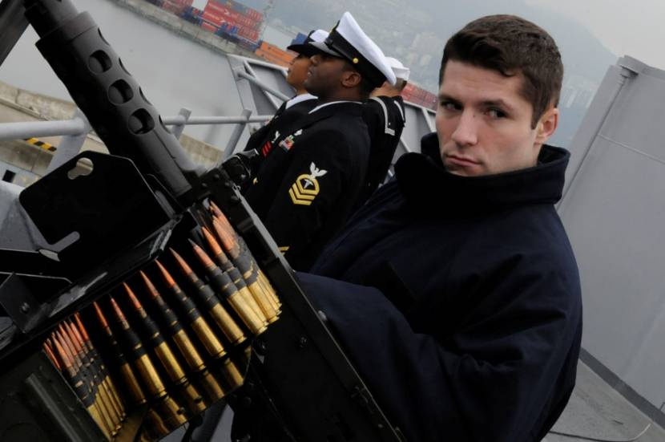
Discipline
Military Discipline: The End Result
A well-disciplined military unit accomplishes routine tasks efficiently and responds automatically to an emergency without panicking.

Slide 32
Discipline
True Discipline and Self-Discipline
True discipline demands loyal but reasoned obedience to authority. It allows for initiative. It is present even when leader is absent.
Self-discipline reduces the need for specific rules and regulations such as:
Traffic laws
UCMJ
Civil rights laws
Drug and alcohol laws
Dress codes

Slide 33
Discipline
Self-Disciplined People
Self-disciplined people:
Need little or no supervision
Realize there is a need for self-control
Develop self-discipline by repeatedly practicing self-control in day-to-day life
Are the ones who hold up in the face of hardship and danger

Slide 34
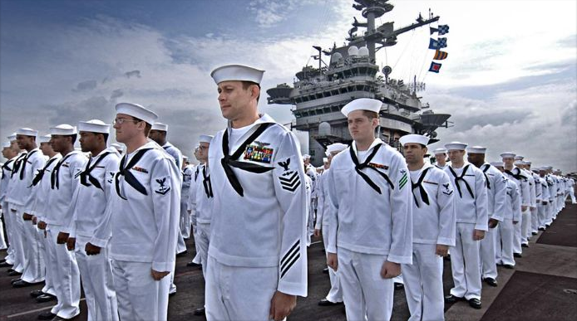
Discipline
Disobedience of Regulations
Disobedience of regulations must be handled:
Immediately
Justly
Consistently

Slide 35
Discipline
Inconsistency in Disciplinary Action
Inconsistency in disciplinary action causes:
Confusion
Poor morale
Distrust of leader
Defiant and indifferent attitude toward other regulations

Slide 36
Discipline
Two Rules of Disciplinary Action
There are two basic rules pertaining to disciplinary action:
1. Never make a regulation that you cannot or will
not enforce.
2. Take immediate, fair action that leaves no doubt
in the mind of the offender about the reason for
the reprimand or punishment.

Slide 37
Discipline
Delay in Disciplinary Action
Delay in disciplinary action causes resentment toward the entire system.
It also prevents the bringing about of necessary changes.
Act immediately and consistently.

Slide 38
Discipline
Leniency in Disciplinary Action
Leniency related to disciplinary action penalizes good people while favoring bad ones.
That said, do not overcompensate by overreacting or being arbitrary.

Slide 39
Which of the following statements is true? Self-disciplined people…
need high levels of supervision.
realize there is no need for self-control.
develop self-discipline by repeatedly practicing self-control in day-to-day life.
are the ones who break down in the face of hardship.
1
1
1
1
(NS3-M2U1C2S2:LQ5)

Slide 40
What is the most important key to successful discipline?
Friendliness
Consistency
Aloofness
Delay
Leniency
1
1
1
1
1
(NS3-M2U1C2S2:LQ6)

Slide 41
Loss of Temper = Loss of Control
Loss of Temper
Facts about loss of temper:
It shows personal weakness
It does not improve effectiveness
It does not improve status
It causes loss of control of the situation

Slide 42
Loss of Temper = Loss of Control
Control of Temper
A conscious effort must be made to control anger.
When admonishing error or administering punishment:
Remain calm
Be impersonal
Stay dignified

Slide 43
Loss of Temper = Loss of Control
Loss of Control of Temper
One who loses his or her temper is often:
Inconsistent
Quick-tempered
Constantly shouting
The results of losing one’s temper is often:
Confusion
Loss of effectiveness
Little or no response from subordinates

Slide 44
Loss of Temper = Loss of Control
Remember: Loss of Temper = Loss of Control

Slide 45
Knowing Personnel
Getting to Know Personnel
When getting to know personnel, communicate in a way that creates mutual respect.
Learn the personality and character of subordinates by developing an understanding what makes each one tick.

Slide 46
Knowing Personnel
Getting to Know Personnel
You can learn this information by:
Studying them
Watching them
Learning their approaches to problems
Working with them
Guiding them
Being genuinely concerned about them
Not waiting until there are problems to help them

Slide 47
Knowing Personnel
Ensure Personnel
Make sure personnel:
Are as comfortable and well-cared for as possible
Receive their fair share of privileges
Know their personal and family lives are of real interest

Slide 48
Knowing Personnel
Ensure Personnel (Continued)
Are fully aware of what’s being done on their behalf
Are recognized for their contributions and feel important
Feel their superiors think they are competent

Slide 49
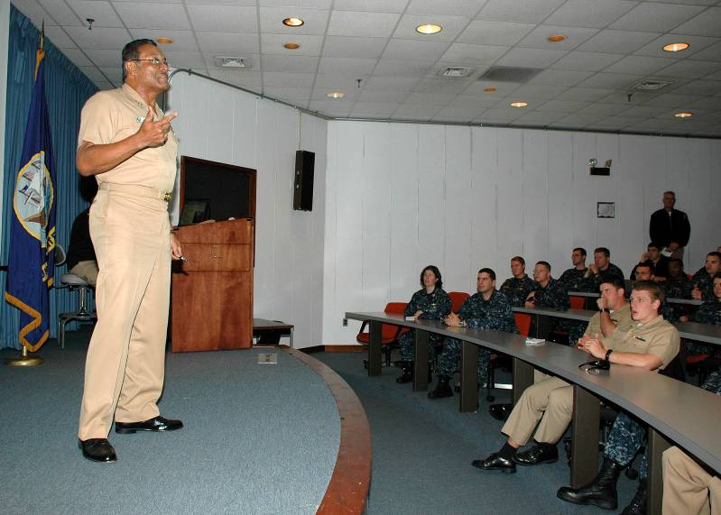
Knowing Personnel
Human Nature
The better your insight is into human nature, and the better you understand the intelligence, education, and backgrounds of your personnel, the more effective a leader you will be when handling people.

Slide 50
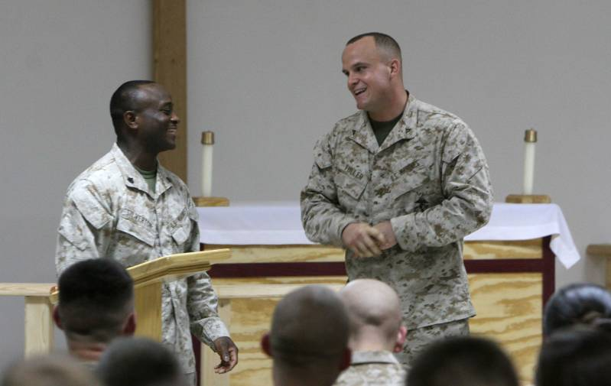
Friendship versus Familiarity
Friendship and Friendliness
Friendship - taking a personal interest in subordinates and talking to them in a friendly manner builds confidence and respect.
Friendliness - if you are friendly and approachable, you will be one of the first ones turned to for advice.

Slide 51
Friendship versus Familiarity
Familiarity
Becoming too familiar with subordinates:
Creates a perception of favoritism
Negatively influences discipline
Breeds contempt

Slide 52
Friendship versus Familiarity
Fraternization
Fraternization occurs when seniors become overly familiar (develop close personal relationships) with personnel of a lower rank, especially personnel in their own chain of command.

Slide 53
Friendship versus Familiarity
Sexual Harassment
Sexual harassment is unsolicited or otherwise undesirable or inappropriate advances of one service member toward another based on sexual attraction, especially involving promises, rewards, or threats of punishment or other forms of intimidation.

Slide 54
Friendship versus Familiarity
Intolerance of Fraternization and Sexual Harassment
Fraternization and sexual harassment are destructive to the morale of everyone on the job.
Those found guilty of fraternization and/or sexual harassment are subject to severe discipline or separation from the service.

Slide 55
Discuss the differences between friendship, friendliness, familiarity, and fraternization.
1.
2.
3.
Note to Instructors:
Click the Show/Hide Response Display Button

Slide 56
Which of the following is an example of moral courage?
Helping to rescue someone who has fallen over a cliff
Pointing out to your teacher that you actually had a higher quiz score than he gave you
Pointing out to your teacher that you actually had a lower quiz score than he gave you
All of these are examples of moral courage.
1
1
1
1
(NS3-M2U1C2S2:LQ7)

Slide 57
After a long day of training, a sailor is complaining of stiff shoulders. Another sailor overhears this complaint and starts rubbing her shoulders. This could be construed as
fraternization.
familiarity.
human nature.
sexual harassment.
1
1
1
1
(NS3-M2U1C2S2:LQ8)

Slide 58
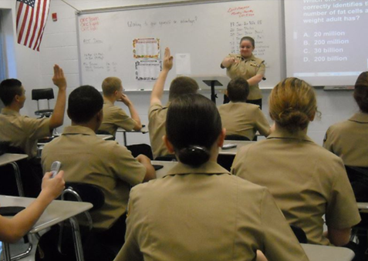

Slide 59
Leaderboard
Last
Slide
Points | Participant | Points | Participant

Slide 60
Team Scores
Last
Slide
Points | Team | Points | Team

Slide 61
Team MVP
Last
Slide
Points | Team | Participant

Slide 62
Whiteboard
Last
Slide

